Slide 1
Standard-setting for the crypto ecosystem: premature or urgent? Evidence from the IASB’s decision
30 May 2025 EAA Annual Congress
David Procházka
Department of Financial Accounting and Auditing

Slide 2
Background & literature review

Slide 3
Background
Industrial Revolution 5.0
Crypto / Blockchain / FinTech / Machine Learning
Crypto ecosystem in a nutshell
bitcoin price 100 tUSD
Crypto trading > GDP of FRA, IT, BRA, CAN
Challenges for
Portfolio management
Accounting / Taxation
MarkCap > 3 tril USD
Banking & financial & energy regulation

Slide 4
Literature review
Stream 01: how to account for transactions involving cryptocurrencies (and other digital assets) in the absence of specific requirements by accounting standards
key question: under which line item to present these assets
normative vs mapping approach
Raiborn & Sivitanides (2015); Tan & Low (2017); Procházka (2018); Stein Smith et al. (2019) & many others for various national GAAP
Stream 02: an appropriate model for the measurement of CCs / digital assets
Ram et al. (2016); Procházka (2018); Klopper & Brink (2023), Hubbard (2023); Beigman et al. (2023); Zhang et al. (2024)

Slide 5
Literature review
Stream 03: analysis of reporting practices
Adhami et al. (2018); Bourveau et al. (2022); Zhang et al. (2022); Luo & Yu (2022)
Stream 04: standard-setting perspective
all papers advocate for a standard-setting action, but the recommendations are rather generic and lack objective criteria to substantiate the need for standard-setting
only few studies adopting a robust theoretical / empirical approach

Slide 6
Literature review
Ramassa & Leoni (2022), applying a regulatory space theory, focus on the IASB’s reluctance to respond to requests from national standard setters to develop a standard
Chou et al. (2022) gather insights from in-depth interviews with crypto industry experts who oppose standard-setting due to unfinished developments
In contrary, Jackson & Luu (2023) consider the same argument (unfinished developments) as the reason for action
Luo & Yu (2022) argues in favour of standard-setting based on the empirical evidence of diversity in accounting practices by firms
Barth (2022) discusses the pitfalls associated with attempting to fit newly created assets into definitions, measurement and recognition criteria originally designed for other assets

Slide 7
Objective of the paper
To examine the urgency of standardising accounting for the crypto ecosystem under IFRS
To critically assess the absent standard-setting from the perspective of different IASB‘s stakeholders

Slide 8
The IASB‘s activities

Slide 9
IASB actions
IFRS IC decision 2019 (accounting for cryptocurrencies by holders)
Third Agenda Consultation 2022:
March 2022: accounting for crypto included on the shortlist of 7 potential projects identified as urgent by respondents of RFI
April 2022: final decision not to include into the agenda, nor to have this project in a research pipeline or reserve list

Slide 10
IASB‘s assessment under Third Agenda
Significance to users ☑
A high priority rating to the project by users
Entities affected ☑
The effects not uniform and tends to vary, but an increasing number of entities being effected
Presence of deficiencies ☑
The application of current IFRS does not yield information that is useful for users
Issue pervasiveness ☒
The impact of crypto ecosystem is not material

Slide 11
Shortcomings of the IASB assessment
3 out 4 Due Process Handbook criteria met
4th criterion (pervasiveness of the issue) assessed mainly with reference to the IASB‘s designed research:
selected IFRS reporters
median share of cryptoassets at 3% of total assets → conclusion: the issue is not widespread and important enough for standard setting
But:
no information on the sample selection (most likely crypto solution vendors and other entities with known exposure)
research made in 2018 & 2019, despite the decision taken in 2022
only figures reported in the financial statements were examined
respondents in the RFI highlighted the changing approach of regulators in favour of digital assets leading to their increasing usage

Slide 12
Methodology

Slide 13
Methodology
Sample:
the annual reports of 50 large European companies included in the STOXX50
period 2018-2022
Method:
the textual analysis of the reports using R package quanteda (Benoit et al., 2018)
first, searching for all occurrences of crypto-related keywords
second, clustering the information about crypto-transactions based on their nature and geography within the annual reports
third, contextualising the narrative information

Slide 14
Results

Slide 15
Annual reports containing the keywords
Year 2022 | FS: notes | MC: regulation | MC: business model | MC: usage | Total
blockchain | 0 | 1 | 11 | 8 | 20
crypto | 2 | 3 | 6 | 7 | 18
digital asset | 1 | 3 | 3 | 1 | 8
ledger | 0 | 0 | 4 | 0 | 4
NFT | 0 | 0 | 1 | 4 | 5
stablecoin | 0 | 2 | 1 | 0 | 3
token | 0 | 0 | 0 | 3 | 3
virtual assets | 0 | 2 | 0 | 0 | 2
Total | 2 | 5 | 16 | 15 | 27

Slide 16
Keywords count across annual reports
Year 2022 | FS: notes | MC: regulation | MC: business model | MC: usage | Total
blockchain | 0 | 1 | 16 | 14 | 31
crypto | 7 | 20 | 7 | 10 | 44
digital asset | 3 | 3 | 5 | 6 | 17
ledger | 0 | 0 | 6 | 0 | 6
NFT | 0 | 0 | 1 | 12 | 13
stablecoin | 0 | 6 | 1 | 0 | 7
token | 0 | 0 | 0 | 3 | 3
virtual assets | 0 | 5 | 0 | 0 | 5
Total | 10 | 35 | 36 | 45 | 126

Slide 17
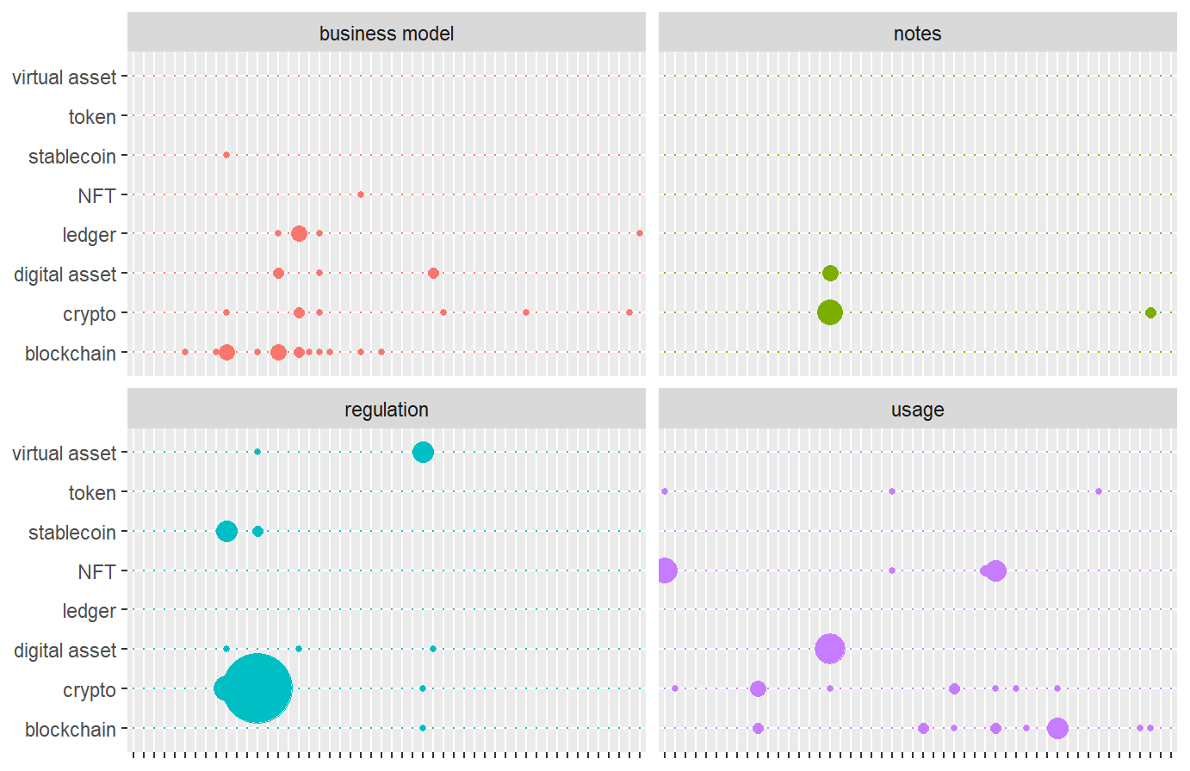
Frequency and geography

Slide 18
Conclusions

Slide 19
Main takeways
The effect on the financial statements is limited
Firms heavily invest into crypto-based solutions
Management commentaries contain information & amounts on:
training
internal investing (R&D expenses)
M&A
Due the nature of crypto ecosystem (rapid developments), the material impact on the financial statements of more entities is a matter of time

Slide 20
Implications
Reluctance to standard-setting undermines the IASB‘s role
The approach “too difficult to standardise” may compel investors to seek information outside the boundaries of financial reporting (Barth 2022)
An incentive to standardise may occur as a result of external shock (analogy to IFRS 9)
The question is whether to have a separate standard or to update the current standards:
questions regularly raised within ongoing two major projects on Intangibles & Cash flow statement
important for SMEs
Despite the IASB‘s decision process transparent in gneral, still some areas are „black boxes“

Slide 21
Thank for your attention And do not forget to come next year for the …
David Procházka
https://kfua.vse.cz/english/prochazka/

Slide 22
European Accounting Association
48th Annual Congress
27-29 May 2026
Prague University of Economics and Business

