Slide 1
Accounting for customer credit risk: preparers’ comments on IFRS 15, the IASB’s response and the aftermath
16 May 2024 EAA Annual Congress
David Procházka
Department of Financial Accounting and Auditing

Slide 2
Background & literature review

Slide 3
Background
To examine the participation in the due process of IFRS 15:
focus on preparers’ responses on to the proposed accounting framework for customer credit risk (CCR)
Prior literature on lobbying:
rationale to engage in or abstain from lobbying (Watts & Zimmerman, 1978, Sutton, 1984, Schalow, 1995)
lobbying patterns by different groups (Larson & Brown, 2001, Chee Chiu Kwok & Sharp, 2005) & strategic behaviour (Amershi et al., 1982, Jorissen et al., 2012)
legitimacy of the process (Himick et al., 2016, Pelger and Speiss, 2017)

Slide 4
Background
Prior literature on revenue recognition:
mathematical (Antle & Demski, 1989) and theoretical framework Dutta & Zhang (2002)
limited capital market / contracting effects (Davis, 2002, Bowen et al., 2002, Zhang, 2005, Altamuro et al., 2005, Caylor, 2010)
conceptual debate during the development phase of the RRP Wüstemann & Kierzek (2005) Schipper et al. (2009) Marton & Wagenhofer (2010) Barker (2010) and Nobes (2012)
growing stream of the literature on various aspects of IFRS 15 / ASC 606 (e.g. EAA comment letter for IASB‘s IFRS 15 PIR)

Slide 5
Accounting for CCR in a nutshell
 | IAS 18 (1993/201) | DP (2008) | ED (2010) | R-ED (2011) | IFRS 15 (2014)
Amount of revenue | “Full” transaction price | Not discussed | Reduced by initial CCR estimate | “Full” transaction price | “Full” transaction price
(Un)collectability | Recognition threshold | Not discussed | Measurement principle | Measurement principle | Recognition threshold
Initial presentation of CCR | Expense | Not discussed | Included in the revenue line | Adjacent line to the revenue line | Expense
Subsequent changes in CCR | Adjustment to expense | Not discussed | Other expense/income | Adjacent line to the revenue line | Adjustment to expense

Slide 6
Motivation
Accounting for CCR is fundamental to the definition of income / expense
The only topic covered in ED 2010 & R-ED 2011, but not discussed previously (included „by surprise“)
Several substantial and unforeseen changes in the proposed accounting treatment → inability to defend the last proposal (with the highest decision-usefulness to users)

Slide 7
Research questions
RQ1
The engagement of constituents in the due process and arguments raised regarding the CCR
RQ3
The impact of IFRS 15 on the disclosures of commenting preparers
RQ2
The IASB’s response to the comment letters

Slide 8
Methodology & results

Slide 9
Sample
 | DP | ED | R-ED | Total | DP | ED | R-ED | Total
Preparer | 79 | 212 | 152 | 443 | 37.4% | 51.0% | 42.2% | 44.9%
Industry organisation | 32 | 50 | 53 | 135 | 15.2% | 12.0% | 14.7% | 13.7%
Auditors | 9 | 31 | 29 | 69 | 4.3% | 7.5% | 8.1% | 7.0%
Consultant | 0 | 2 | 2 | 4 | 0.0% | 0.5% | 0.6% | 0.4%
Standard setter | 18 | 22 | 25 | 65 | 8.5% | 5.3% | 6.9% | 6.6%
Public body | 0 | 6 | 9 | 15 | 0.0% | 1.4% | 2.5% | 1.5%
Regulatory body | 3 | 6 | 6 | 15 | 1.4% | 1.4% | 1.7% | 1.5%
User | 6 | 8 | 13 | 27 | 2.8% | 1.9% | 3.6% | 2.7%
Academia | 3 | 18 | 16 | 37 | 1.4% | 4.3% | 4.4% | 3.7%
Individual | 14 | 13 | 9 | 36 | 6.6% | 3.1% | 2.5% | 3.6%
Professional organisation | 40 | 48 | 46 | 134 | 19.0% | 11.5% | 12.8% | 13.6%
Other | 7 | 0 | 0 | 7 | 3.3% | 0.0% | 0.0% | 0.7%
Total | 211 | 416 | 360 | 987 | 100.0% | 100.0% | 100.0% | 100.0%

Slide 10
Sample
37 European firms reporting under IFRS (financial sector excluded)
Quantitative disclosures examined:
the net amount of trade receivables (including contract assets in 2018) at the end of the period;
the amount of allowances to trade receivables at the end of the period;
the reconciliation of the opening and closing balance of allowances;
the maturity of trade receivables, with a focus on the breakdown of overdue receivables;
the geography of quantitative information within the notes
Qualitative disclosures examined:
descriptions of the accounting policies related to trade receivables → NLP

Slide 11
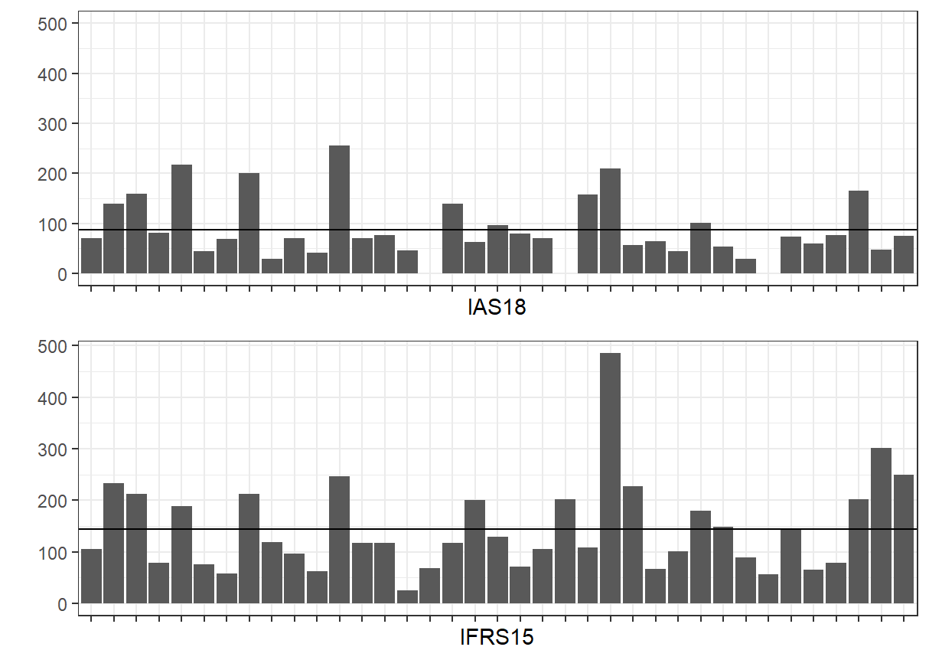
Qualitative disclosures: length

Slide 12
Qualitative disclosures: length
Regression model | Policy length
Constant | -69.317
“IFRS15” policy dummy | 53.712***
Size | 5.728**
Leverage | -0.498
Impairment | -242.147
Industry effects | Included
Country effects | Included
F-test | 3.99***
R² | 0.486
R²_{adjusted} | 0.364

Slide 13
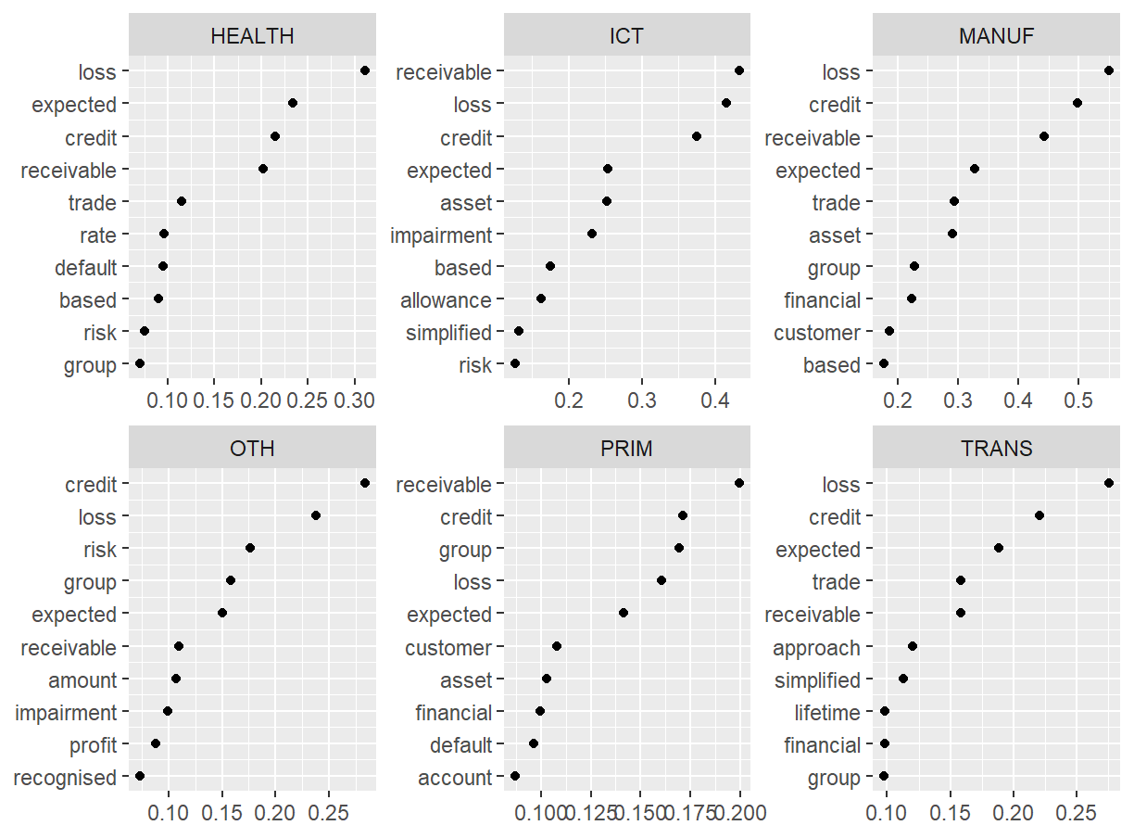
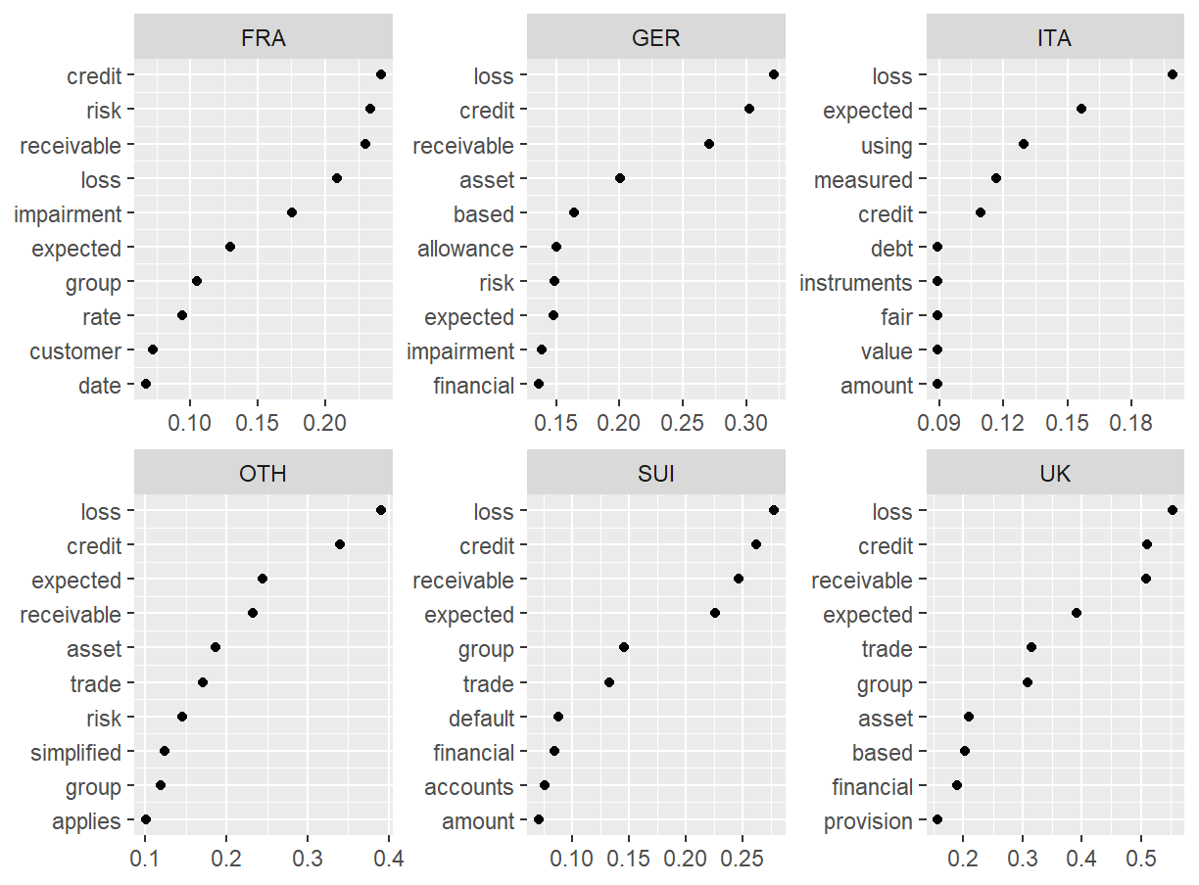
Qualitative disclosures: word frequency

Slide 14
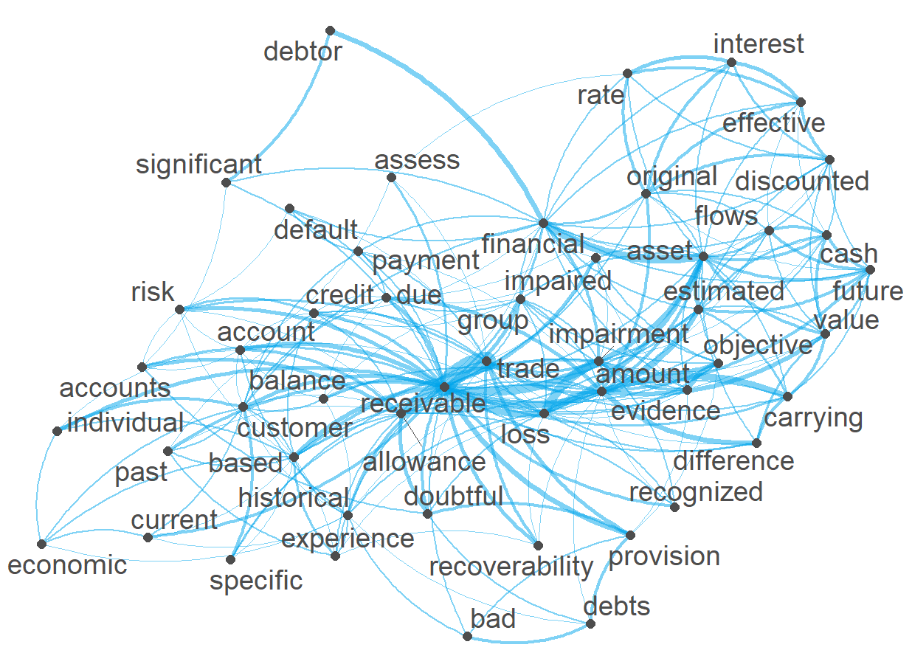
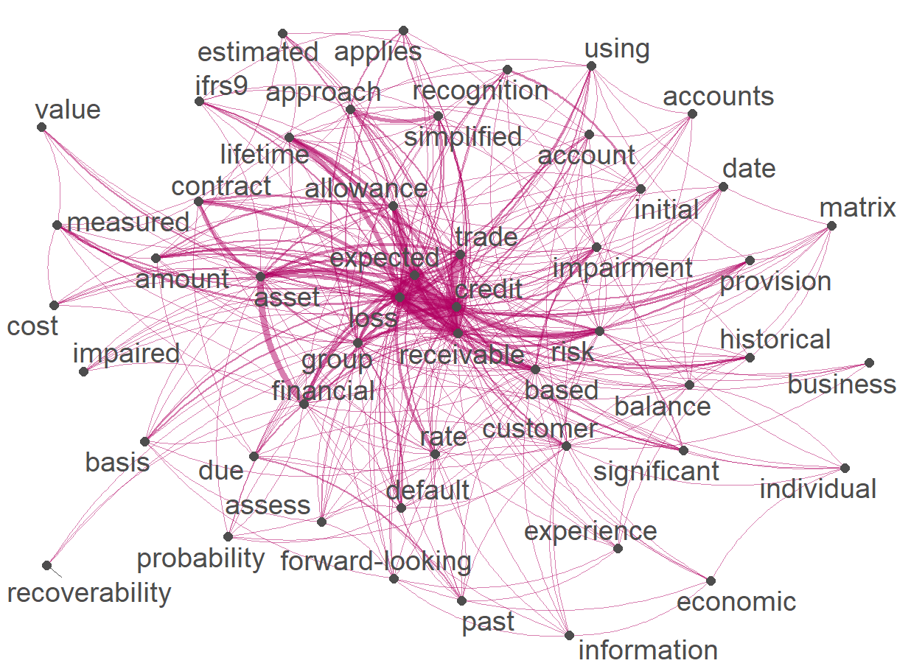
Qualitative disclosures: words co-occurences
IAS 18
IFRS 18

Slide 15
Quantitative disclosures: information disclosed
 |  | „IAS 18“ policies |  |  | „IFRS 15“ policies
INDUSTRY | Obs. | Impairment | Changes | Ageing | Impairment | Changes | Ageing | ECL method
Primary | 5 | 5 | 4 | 5 | 5 | 4 | 5 | 3
Manufacturing | 11 | 10 | 8 | 9 | 10 | 8 | 6 | 8
ICT | 9 | 9 | 8 | 8 | 9 | 8 | 8 | 11
Health | 4 | 4 | 3 | 4 | 4 | 3 | 4 | 1
Transport | 4 | 4 | 2 | 4 | 4 | 2 | 3 | 4
Other | 4 | 4 | 2 | 2 | 4 | 3 | 2 | 2
Total | 37 | 97% | 73% | 86% | 97% | 76% | 76% | 76%

Slide 16
Quantitative disclosures: geography
Panel B |  | „IAS 18“ policies |  |  |  | „IFRS 15“ policies
INDUSTRY | Obs. | Trade receivables | IFRS7 | Mixed | NR | Trade receivables | IFRS7 | Mixed | NR
Primary | 5 | 2 | 1 | 2 | 0 | 2 | 1 | 2 | 0
Manufacturing | 11 | 6 | 2 | 2 | 1 | 3 | 3 | 2 | 3
ICT | 9 | 8 | 0 | 1 | 0 | 6 | 3 | 0 | 0
Health | 4 | 2 | 1 | 1 | 0 | 2 | 1 | 1 | 0
Transport | 4 | 2 | 1 | 1 | 0 | 1 | 1 | 1 | 1
Other | 4 | 3 | 0 | 0 | 1 | 4 | 0 | 0 | 0
Total | 37 | 62% | 14% | 19% | 5% | 49% | 24% | 16% | 11%

Slide 17
Conclusions
Narrative disclosures:
under IFRS 15 longer narrative description of accounting policy for CCR
based on cosine similarity index, under IFRS 15 higher adherence to the official IASB‘ text (more boilerplate descriptions)
some firms still utilise terminology & guidance from IAS 11 (& IAS 39), despite IFRS 15 (& IFRS 7) were in place
Quantitative:
less information in general & decrease in disclosure of ageing
less organised (in many cases aggregated with other AC financial assets)

Slide 18
Thank for your attention
David Procházka
https://kfua.vse.cz/english/prochazka/

