Slide 1
(Demand for) financial reporting and the role of IFRS
Poznan University of Economics and Business, Monday 27 March 2023
David Procházka
Department of Financial Accounting and Auditing

Slide 2
Agenda
The role of capital markets
Investment strategies
The role of IFRS adoption
Practical issues in the multinational entities (MNEs)

Slide 3
The role of capital markets

Slide 4
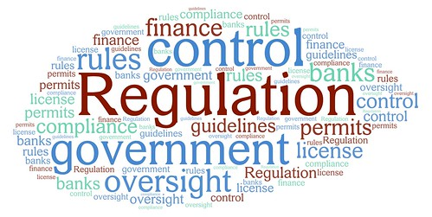











The importance of capital market

Slide 5
The importance of capital market
Capital market = essential institution connecting providers of capital (investors) with firms
Institutionalised markets (stock exchanges):
  more capital available (more investors diversifying risks)
  higher transparency required
  lower cost of capital
  higher liquidity (an investor may quickly close the involvement in a company by selling the shares/bonds)
Flows between investors and firms:
  monetary flows (investment to a firm & return on the investment paid out by the firm)
  information flows (financial statements; press conferences; earnings announcements)
A relatively strict regulation to ensure the smooth functioning of capital markets (SEC, PCAOB)

Slide 6
A public firm
Division A
Division B

Slide 7
A private firm

Slide 8
Organisational structure and external relations
Private vs Public (listed) firms:
  capital markets force discipline of managers and may mitigate principle-agent problem when ownership and management are separated
  more stakeholders involved with public firms (even if a private firm is considerably bigger and organisational structure more complicated)
What‘s specific by public firms:
  the existence of regulator of capital markets requires specific compliance departments by issuers
  following by financial analysts & rating agencies
  an independent audit committee may be compulsory

Slide 9
Investment strategies

Slide 10
Investment goals
Do you want to beat the market or just to play it safely?
Goal (pension, goods ...)
Value
Income
Impact (ESG)
Psycho
Growth
If to beat the market, how to identify appropriate instruments?

Slide 11

Strategies
Passive strategy:
  I admit that I cannot beat the market ⬄ monkey investment theory
  effective portfolio selection makes the sense (investing in the market index to remove unsystematic risk ⬄ not having all eggs in one plate)
Active strategy:
  ...

Slide 12
Markowitz effective portfolio

Slide 13

Strategies
Passive strategy:
  ...
Active strategy:
  I believe that I can beat the market
  focus on the stock picking (i.e. searching for appropriate individual investments) & relatively frequent trading & higher fees
  a good candidate of an instrument is that whose market price deviates from its intrinsic value (theoretical value incorporating all value drivers)

Slide 14
How to identify an appropriate instrument
Long position
Intrinsic value > market price
Buy the instrument
Short position
Intrinsic value < market price
(Short) sell the instrument
Indifferent
Intrinsic value = market price
Hold (or do not buy)

Slide 15
How to determine the intrinsic value
Fundamental analysis of:
  (global/national) economy
  industry
  financial statements
Analysis of the financial statements:
  analysis of the past to predict the future
  focus on the key value drivers (revenue, margins, leverage, assets turnover etc.)
  it is desirable to have a benchmark (own vs reference to peer companies) → benchmark should be comparable

Slide 16
Fundamental analysis
Analysis of financial position |  | Financial position: assessment based on financial statements
 |  | Good | Bad
Financial position: real | Good | OK | Type I error
 | Bad | Type II error | OK
Assessing financial health of a company is the same as statistical testing of a hypothesis
Probability of Type I error interconnected with the probability of Type II error: the only way how to reduce the probability of both errors simultaneously is to increase „the sample“ ⬄ i.e. to collect more information → time and costs
Financial position in financial statements is a function of fundamental performance & accounting policies & motivation to manipulate

Slide 17
The role of IFRS adoption (theory)

Slide 18
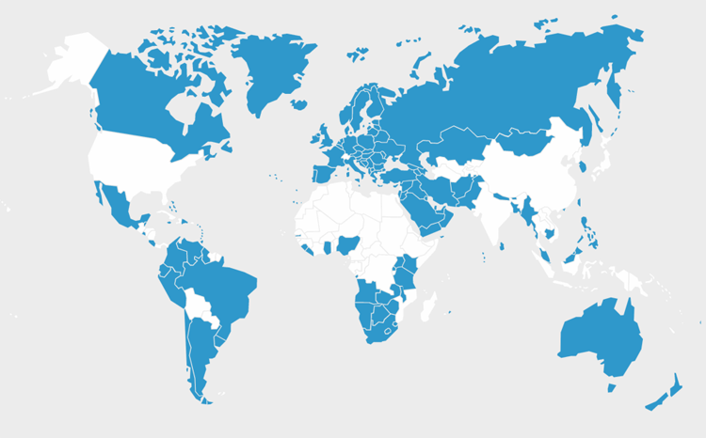
Financial reporting in general
Legal background:
  each country has power over its accounting regulation, but
  many countries have decided to share a common regulation (e.g., the EU)
  differences in financial reporting requirements on public vs private firms & the size of a company can be another factor of differences in requirements (usually only regarding the private firms)
Economic background:
  worldwide integration of markets (including capital markets) → globalisation is the main force pushing forward the accounting harmonisation
  the main objective of accounting harmonisation: international comparability of financial statements
  better comparability → lower information processing costs → higher cross-border investments
  intensive adoption of the International Financial Reporting Standards (IFRS) around the world (currently more than 140 jurisdictions)
  https://www.ifrs.org/

Slide 19
Economic logic behind IFRS adoption
Single set of high-quality financial reporting standards used around the world
Internationally comparable high-quality financial statements
Lower information processing costs and risks by users
Positive capital market effects (cost of capital, trading volumes)
Positive macroeconomic effects (FDI, employment, growth)

Slide 20
Economic effects of IFRS adoption in detail
Intended consequences
Capital markets
Macroeconomy
Unintended consequences
Microeconomy
Macroeconomy
Financial reporting quality
Earnings management
Value relevance
Cost of capital
Liquidity, trading volumes
Contracting
Taxation
Management accounting
Regulatory tasks
Other
Signalling
Employment, growth

Slide 21
The role of IFRS adoption (reality)

Slide 22
Value relevance of earnings
Theory: high-quality financial statements transmit information useful for investors → information incorporated into the share price
Reality: the association is usually lower than one would expect because:
  financial statements are published relatively late after the end of the period
  accounting is not an exclusive source of financial information
  investors reward voluntary disclosure beyond mandatory requirements & voluntary disclosure shall be reliable (credible) → role of company‘s reporting incentives
Only unexpected information can significantly influence the share price → the temptation to manage earnings
The reaction depends on:
  relation between reported and expected earnings (based on consensus analysts‘ earnings forecasts)
  market efficiency (weak, semi-strong, strong) influences the speed and accuracy of the reaction to new information)

Slide 23
Factors of accounting quality
The benefits of accounting harmonisation are not automatic:
  the quality of financial reporting is the function of a country‘s institutional framework & quality cannot be imported per se → wider economic reforms are needed
Accounting quality is determined by:
  reporting incentives by firm ⬄ how much they want to publish high-quality financial statements
  enforcement regime (institutional background) ⬄ how effective the regulation is concerning the compliance with IFRS
A joint influence of the firms‘ reporting incentives and institutional environment on:
  the level of earnings management
  the quality and extent of narrative and other disclosures

Slide 24
Earnings management (channels)
Increasing the share price by:
  good management of the company
  earnings management
How to manage earnings:
  ↑ DIV = EPS * p ⬄ ↑ profits or ↑ payment ratio
  ↓ r_{reg} ⬄ ↓ the risks perceived by investors, e.g., through having stabilised profits
  ↑ g = ROE * (1-p) ⬄ ↑ ROE (improve the relation between EAT and Equity, e.g. by ↑ profits or by leveraging, which is risky and may increase r_{reg}) or by ↓ payment ratio
EM can take many forms, but the effects are not always straightforward → advantage for knowledgeable users

Slide 25
Earnings management (forms and techniques)
Forms:
  accrual EM ⬄ (ab)using the boundaries of accrual accounting
  real EM ⬄ artificial real transactions to mask the true situation
Creative accounting techniques:
  selection depends on the goal of EM/IS
  off balance sheet financing; Special Purpose Entities vs
  big bath; overpriced business acquisitions vs
  revenue over/underestimation; depreciation; impairment

Slide 26
Earnings management (detection)
Red flags accounting:
  changes in accounting policies
  increasing revenue not accompanied with increasing impairment of receivables
  increasing revenue not accompanied with increasing working capital
  unusual accruals and deferrals
  capitalisation of internally generated intangibles
  new group entities not consolidated
  increase in cash accompanied with increase in trade liabilities
Red flags external:
  frequent changes of auditors
  frequent changes of CFOs, head accountants
  restrictions on borrowings

Slide 27
Why textual analysis?
Financial statements:
  „hard“ data (but subject to estimates, judgements, management discretion)
  accounting terminology prevailing
  regulated content which is audited
Annual reports:
  contain compulsory (and audited) parts, but also unaudited sections
  usually presents a broader picture of the company operations with management insight
  as such, can provide additional useful information for users, but it may be used for „brainwashing“ (to mitigate / eliminate the concerns about „hard“ financial results)
  plain language prevailing
The content analysis of financial statements:
  should be always done (at least by reading)
  caution is necessary → advance techniques using IT solution (content analysis, sentiment analysis etc.)

Slide 28

CEO letters of DAX companies 2021
Created using https://www.wordclouds.com/

Slide 29
CEO letters of DAX companies 2021
Created using R

Slide 30
CEO letters of DAX companies 2021
Created using R

Slide 31
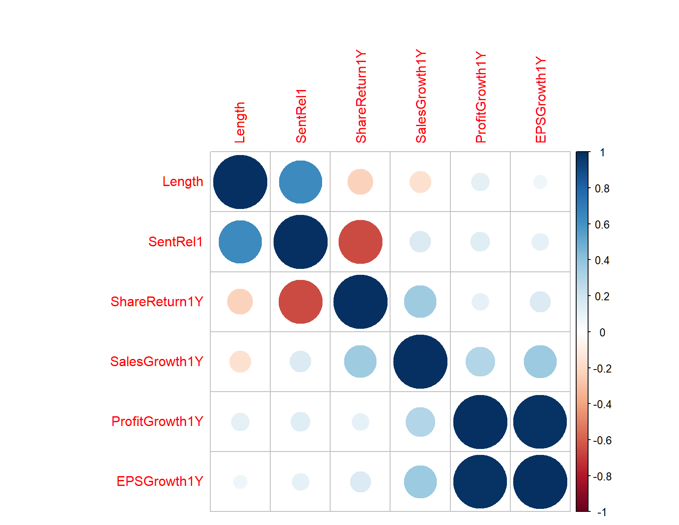
CEO letters of DAX companies 2021
The lower share return (year-to-year), the more positive tone in the CEO letter
And the accounting fundamentals are insignificant
Created using R

Slide 32
Preparing the financial statements: some issues

Slide 33
The reporting system
Parent
Subsidiary A
Joint venture A
At equity A
Subsidiary B
Subsidiary C
Subsidiary D
Subsidiary E
- Separate / individual statutory statements
- Reporting packages
- Consolidated statements
- CSR reports
Information system
Financial & non-financial reporting
Tax accounting
Ad hoc reports
Management accounting
Third party
- Strategic decision making
- Tactical DM
- Operational DM
- Tax fillings for all taxes
- Transfer pricing
- Specific tax reports
- Banks
- Regulators

Slide 34
The reporting system
Listed firms are usually multinational corporations with tens, hundreds or even thousands of subsidiaries
Consolidated financial statements (CFS) shall be prepared because:
  the parent company has power over its subsidiaries → risk of disadvantageous transactions to improve the financial position or performance of the parent or some group members ⬄ theoretically all subsidiaries can be profitable, but the group on the whole is loss making (or vice versa)
  buying shares of the parent means that you invest into the entire business of the group, not only into that individual of the parent → investors interested in the overal performance of the group
The preparation of CFS require:
  alignment of accounting policies by all firms in the group
  converting individual financial statements into one currency
  elimination of any intragroup transactions
  accounting for any rolling-over effects of the past M&A
CFS also need to be assured by an auditor
Tough deadlines for publishing the CFS (3-4 months after the end of reporting period)
Reporting deadline schedule 2023
Deadline input and reconciliation of intercompany transactions
12 January 2023
Deadline complete reporting package
17 January 2023
Confirmation signed by CEO/CFO of reporting unit
19 January 2023

Slide 35
The reporting system
Financial reporting is not the only one source of information required:
  management needs information to decide about operations of the company/group (different level of decision-making)
  fiscal authorities are interested in fair and appropriate collection of taxes
  some stakeholders require specific reports
An ideal information system should integrate all the modules → complex reporting systems & growing usage of shared services within the group & growing usage of artificial intelligence
Despite huge digitalisation, human KNOWLEDGE and SOFT SKILLS will always be essential to operate the reporting systems in an effective and efficient way

Slide 36
Thank for your attention
David Procházka
Web: https://kfua.vse.cz/english/prochazka/
Email: prochazd@vse.cz

